Slide 1
Documentation for Mac Asp.Net Core 2.0
Razor Page addition
By: Areli Muñoz

Slide 2
Leveling The Playing Field Problem & Goal
MLB Players go through contract negotiations with team’s front offices.
Some Athletes are overpaid, and others underpaid.
The goal is to calculate a universal salary for athletes in the MLB
Salary based on individual player stats
Use listed salary made from 2018
Instill our algorithm to calculate the players ideal salary based on their stats
Main Consumers
Team managers
Third party agencies
Individual players’ agents

Slide 3
Overview
Project Features
Login/Register/Main Page/Main Home Calculation Page/Hitters/Hitters Code/Pitchers/Pitchers Code/Behind the Scene Batters & Pitchers
HTML.begin Form
Search
Uploading to Server
Test Cases
Gantt Chart
Link Resources
GETTING Started
Learning Razor
Contents in Razor Pages
**Important
Install packages
**Important
Bootstrap
Game Plan
Final Calculations
Design/ Plan

Slide 4
GETTING Started
GETTING started:
https://docs.microsoft.com/en-us/dotnet/core/tutorials/using-on-mac-vs
https://docs.microsoft.com/en-us/visualstudio/get-started/csharp/tutorial-aspnet-core?view=vs-2019
Models:
https://docs.microsoft.com/en-us/aspnet/core/tutorials/razor-pages/model?view=aspnetcore-2.2&tabs=visual-studio
Example to set up the format in Razor Pages:
https://github.com/ardalis/OrganizingAspNetCore/tree/master/WithRazorPages
Take a look at these tutorials.
Really try to understand before you start Coding.
The last link is an excellent was to see how to organize folders and see how they communicate in .cshtml & .cshtml.cs
Along with watching videos; take a look at linkedInlearning.
Watch the video: ASP.NET Core: Razor Pages
-It’s a course that teaches how to create files, how they communicate, figure out the basics, understand layouts, working with Data, and validation.

Slide 5
Learning Razor
https://www.learnrazorpages.com
All of the contents must include these three things: The naming of a file can’t start with an underscore, the extention is .cshtml, and it started with @page.
We chose Razor instead of MVC because there is only one Root Level to work with then MVC which has 3: Model, View, Controller.

Slide 6
Contents in Razor Pages
.cshtml
.cshtml.cs
@page
@ model [model name]
Html Syntax
asp-for =“” : to communicate with .cshtml.cs file
Namespace
Model
Tag Helpers
Public [data type] [nameOfObject]
OnPost()
Method
OnGet()

Slide 7



**Important**
When you first create your project, you named your project. That name is the namespace for all of your files. If you try to rename it, it won’t rename files you don’t see. So previous files created won’t be able to communicate to your new files. I received an error of namespace along with my Starup.cs, Program.cs; when I started my models to create my forms for the manual calculations they weren’t able to read by models. So essentially the .cshtml and .cshtml.cs weren’t able to communicate.

Slide 8
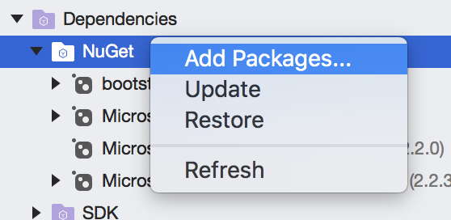
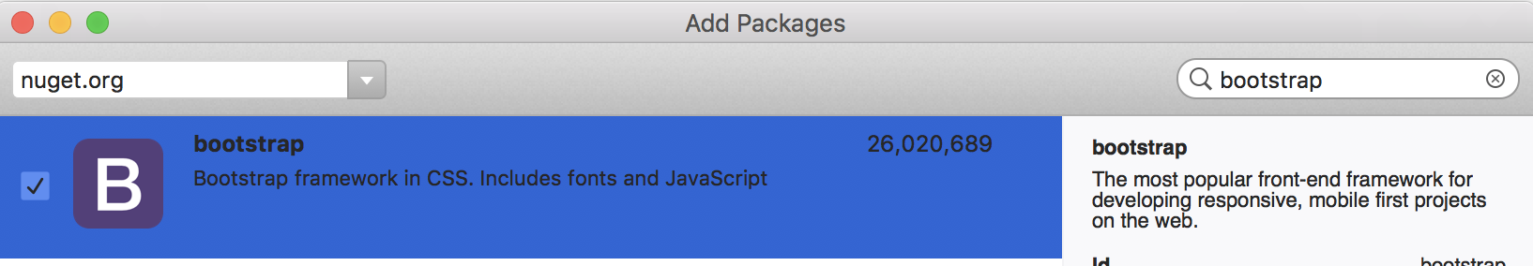
Install your packages from NuGet
For our project we needed to install:
Bootstrap
HtmlAgilityPack
Connected
Dapper

Slide 9
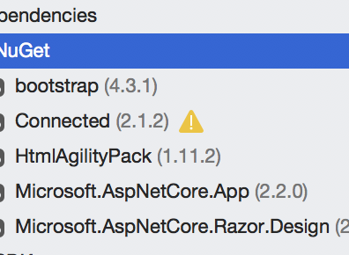
Other Packages came preinstalled:

Slide 10
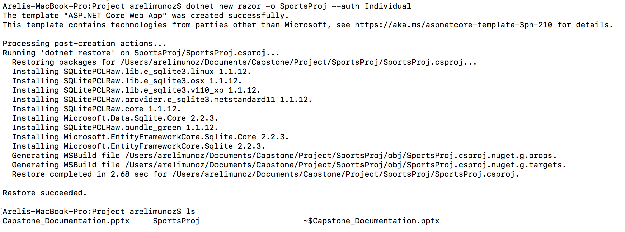
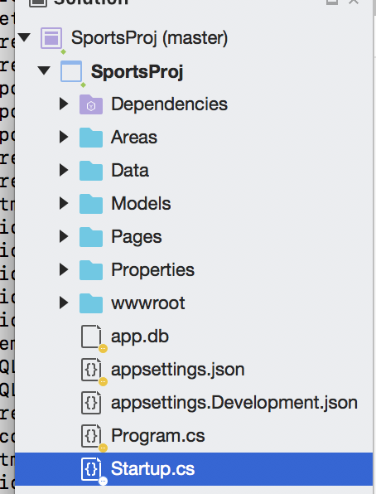
**Important**
The package for Connected has to be installed through terminal:
The code is:
dotnet new razor -o [Name of Project ] --auth Individual
The reason you need the Connected Services is because Microsoft Visual studio has a simple GUI when creating their projects to have it incorporated. Mac needs the terminal code so you can have a Login, Registration, Data, Area folders.

Slide 11
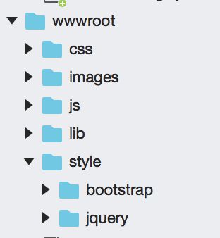
Bootstrap installing Design into Visual Studio Asp.Net Core
Source for template: https://startbootstrap.com/templates/business-frontpage/
https://www.csharpcorner.com/article/asp-net-core-2-0-apply-bootstrap-template/
Note: Make sure you have the correct path on where you place the bootstrap template to display correctly.
In _Layout file in the Shared Folder.

Slide 12
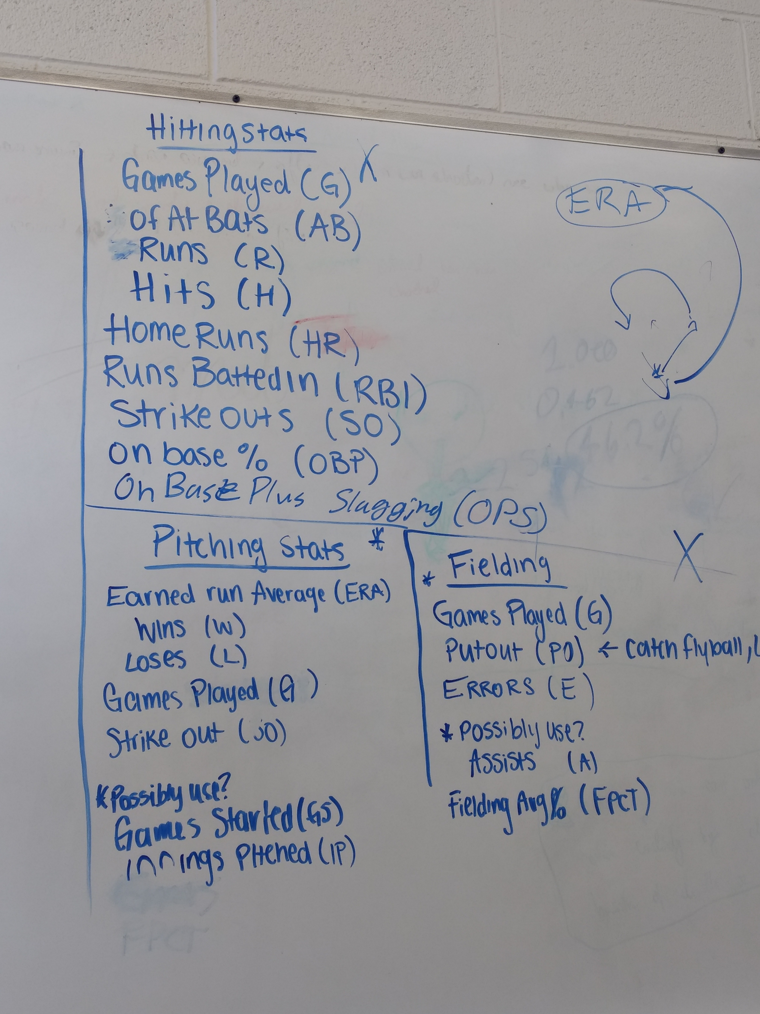
Game Plan
Had meetings to discuss what statistics to include for calculation.

Slide 13
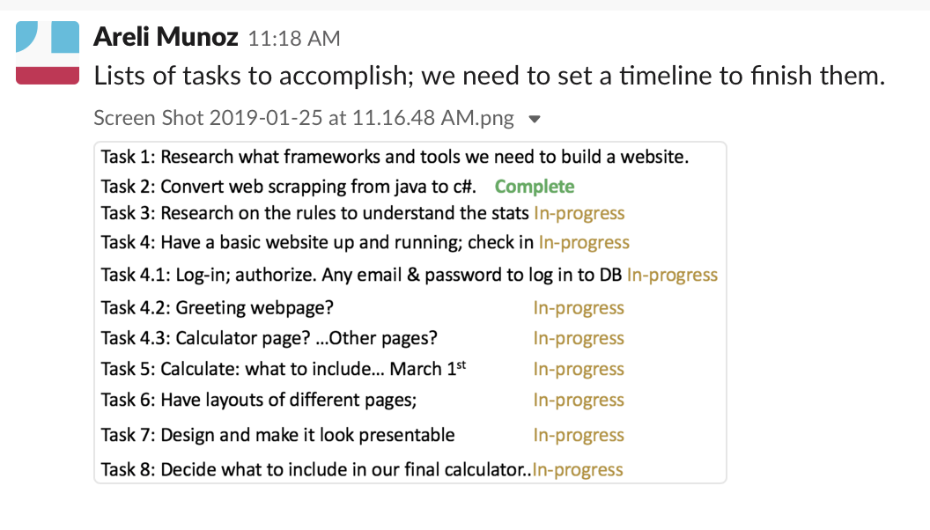
Game Plan
Had tasks to assign and goals to achieve.

Slide 14

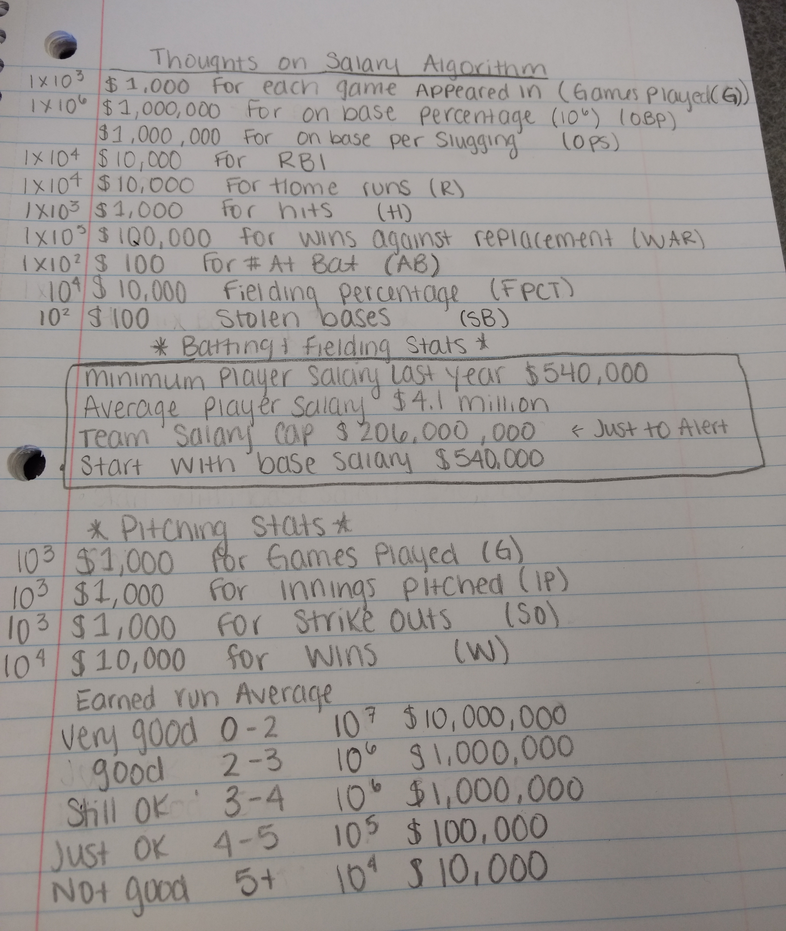
Final Calculation to include in calculator

Slide 15
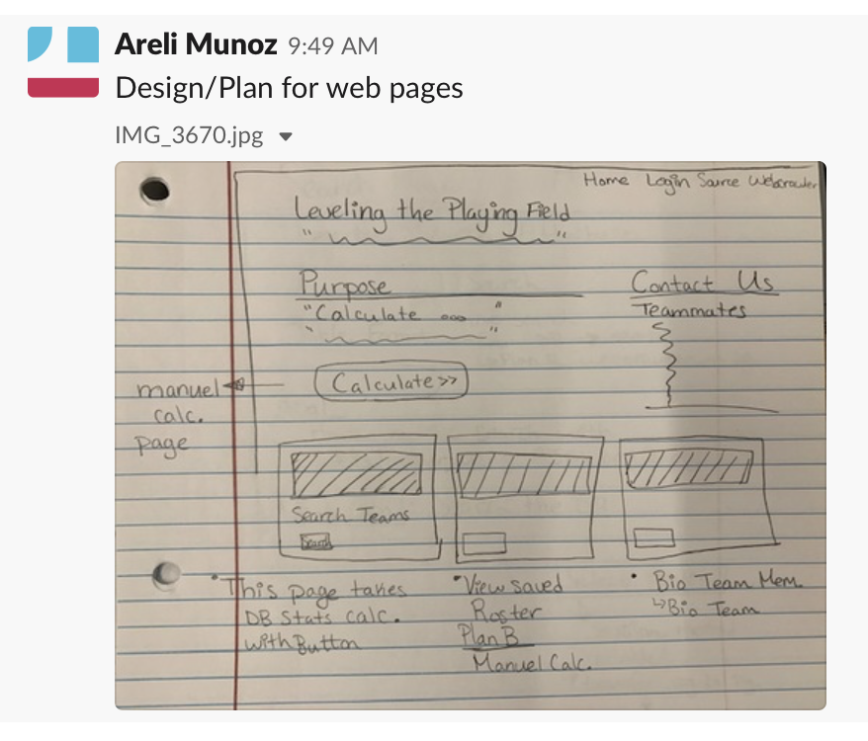
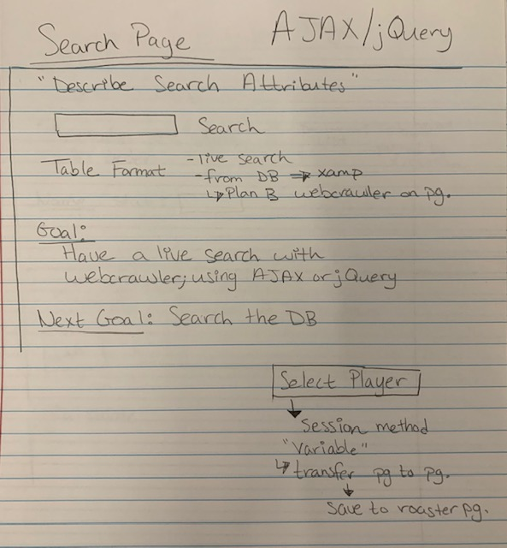
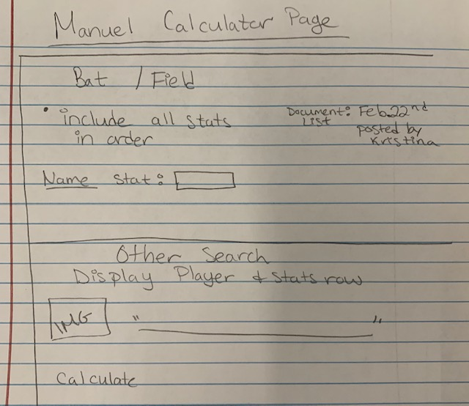
**Important**
Before you start coding, discuss with group on your layout for your project. I designed the main page, search, and calculator page. There were some changes along the way.

Slide 16
Project Features:
Login
Register
Search
Manual Calculator
Main Calculation Page: has access to Pitchers and Hitters Page

Slide 17
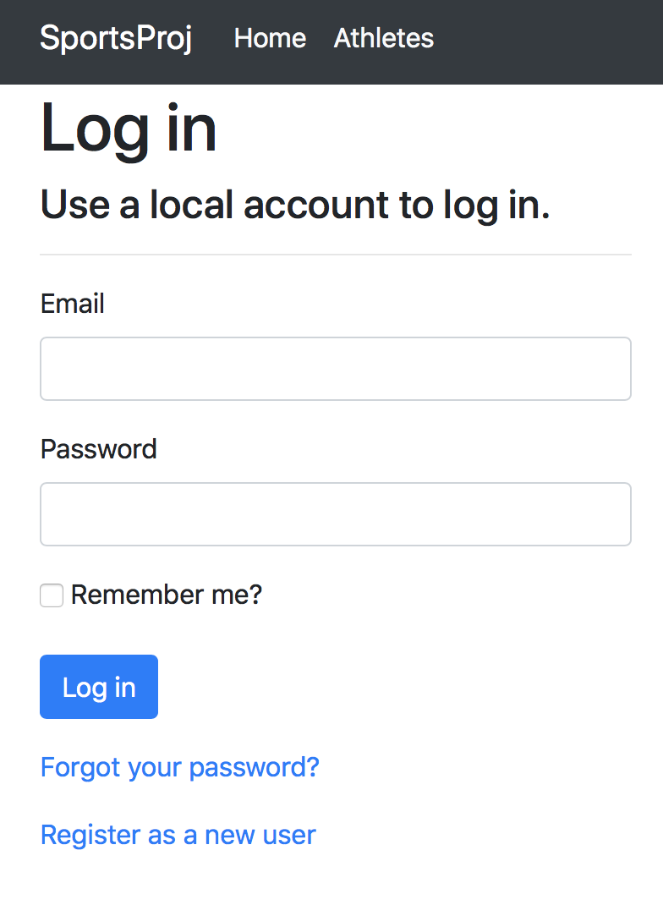
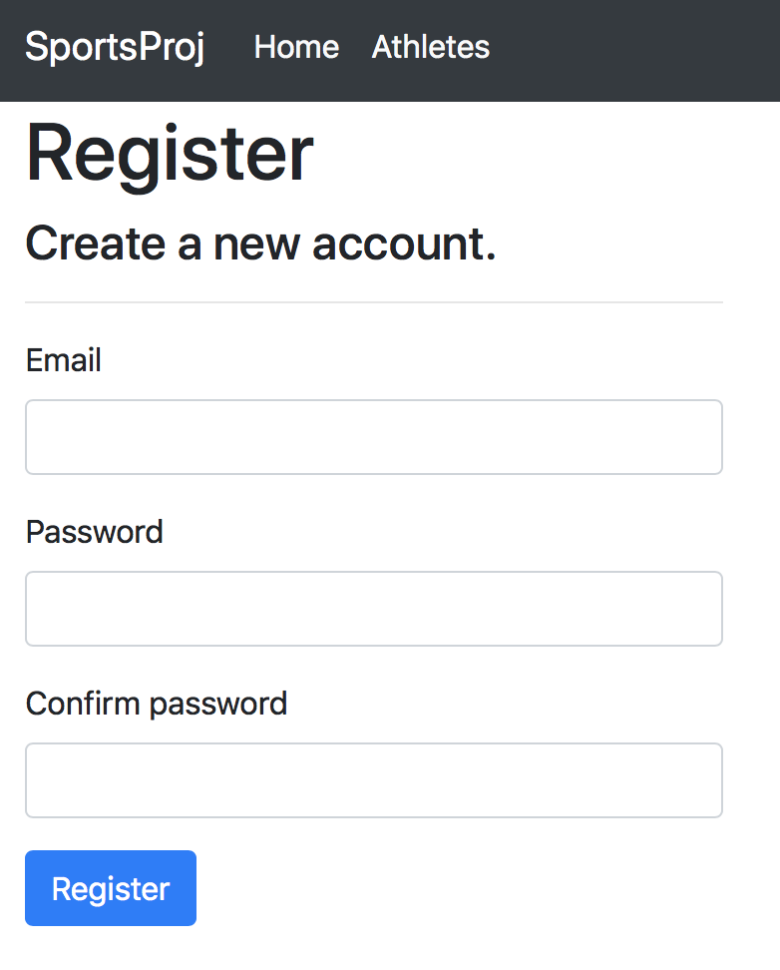
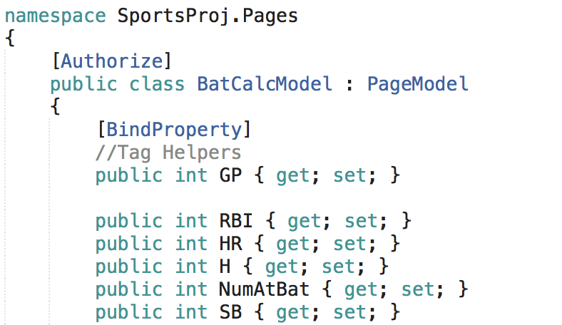
Has validation on email and password.
In order to access certain pages; you need to be logged in. There is a line of code to type: [Authorized] in the .cshtml.cs file. It’s in between the namespace and model brackets.
Sign Up to have access to pages. Like Hitter and Pitchers pages.
This register page sets up itself from the dotnet (new razor -o [Name of Project ] --auth Individual ) command
Login
Register

Slide 18

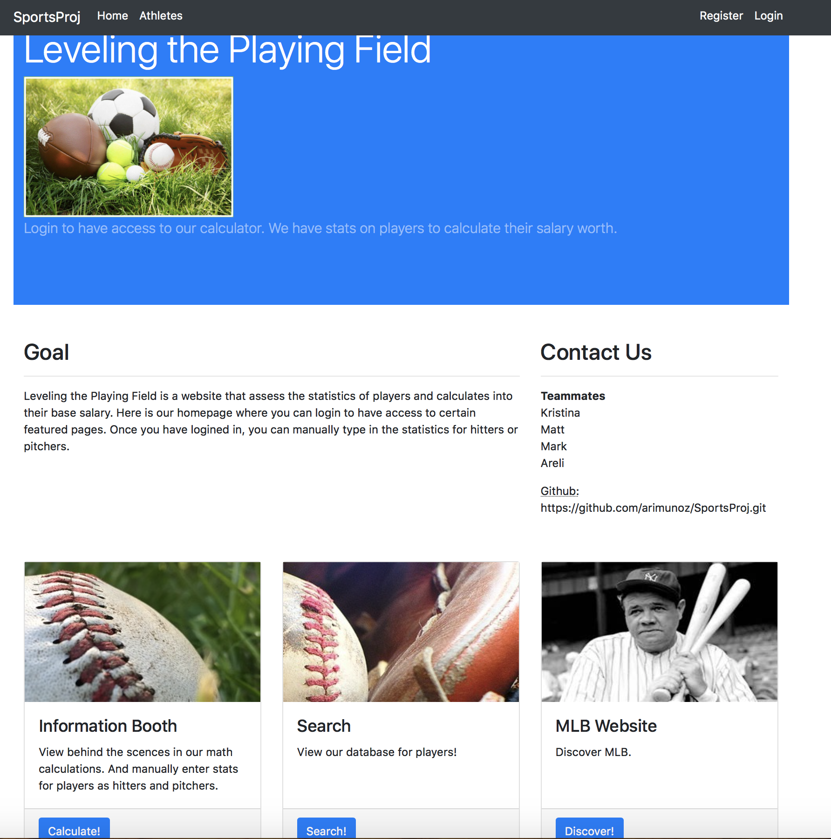

Main Page
With the help of bootstrap, I was able to create this layout. To insert photos you need this tag:
<img src="~/images/LPF.png" style="width:300px; align-content:center" asp-append-version="true" />
**Note: keep your photos organized in a folder. I named my folder images and it’s under the wwwroot folder.

Slide 19
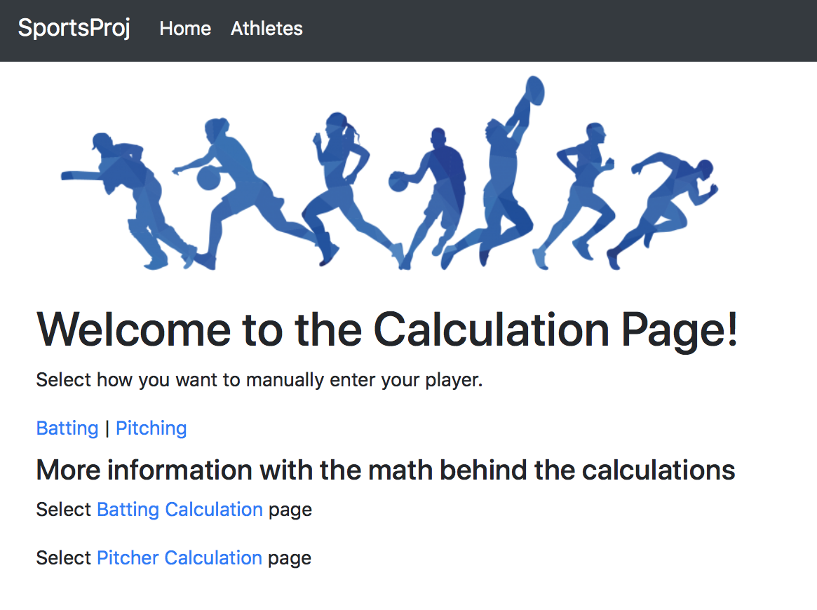
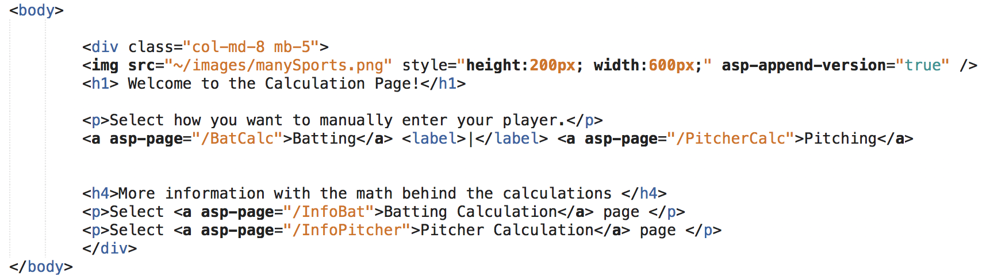
Main Home Calculation Page
I created a home page to have access to hitters and pitchers. Along with the math behind the our calculations.
Be careful with the spacing: it was difficult to space out batting and pitching. So the <label> tags helped.

Slide 20
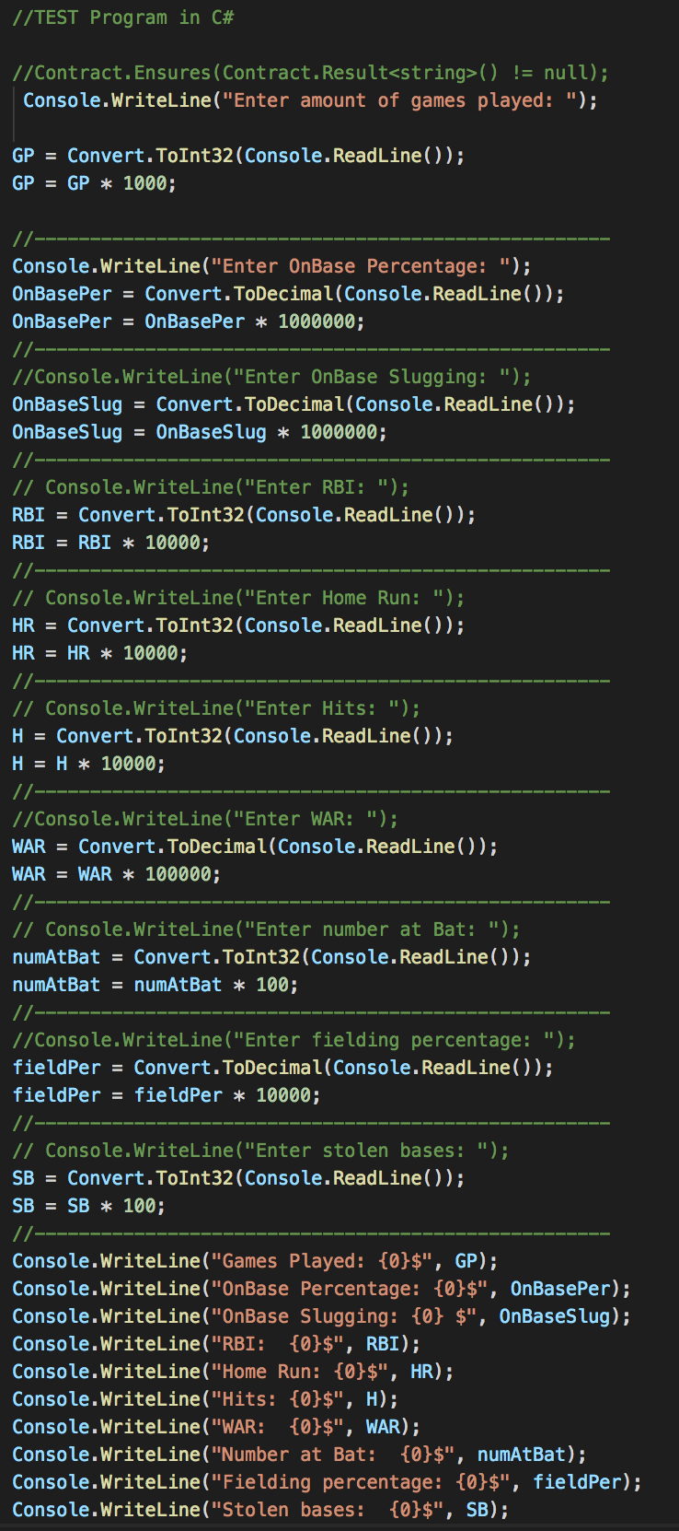
Hitters
To code this page, the backend you need the .cshtml and .cshtml.cs files. The file ending in .cs will deal with c# language. Since I was learning the C# syntax I did a test using visual studio code. From there I was learning how the model communicated with .cshtml. The github example project helped to organize everything.

Slide 21
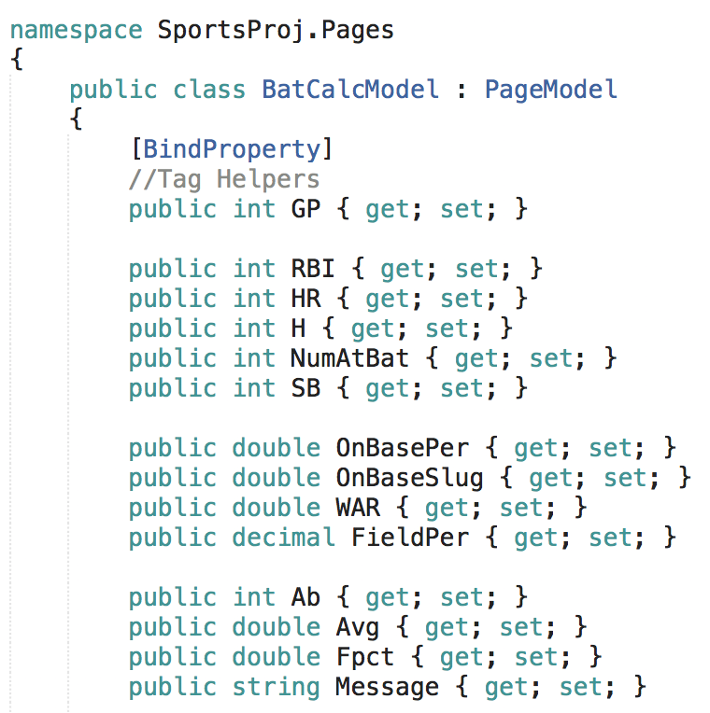
Hitters Code
The model page has the namespace, model, and methods. Within the model there are tag helpers. Tag helpers are there so you can enable server-side code so what user inputs will render HTML elements in Razor pages. So it communicates back in .cshtml file. In that file you can call in the beginning @model {model name}

Slide 22
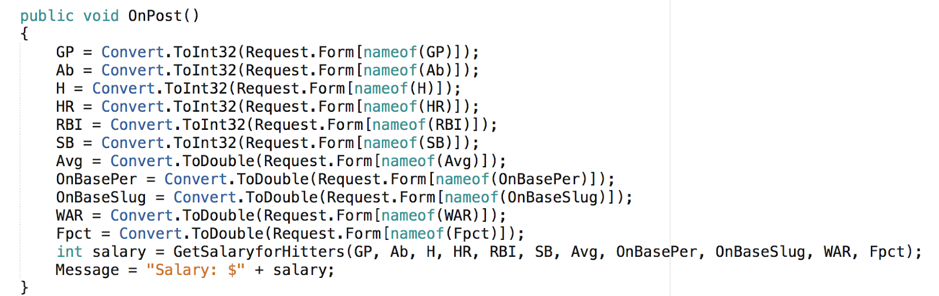
This OnPost() method is the action on the html side. Under the form tag you will see this name under the action =“OnPost”
The requirements whether it is an integer, double, etc will come from the tag helpers mainly and Convert.ToInt32(Request.Form[nameof()]);

Slide 23
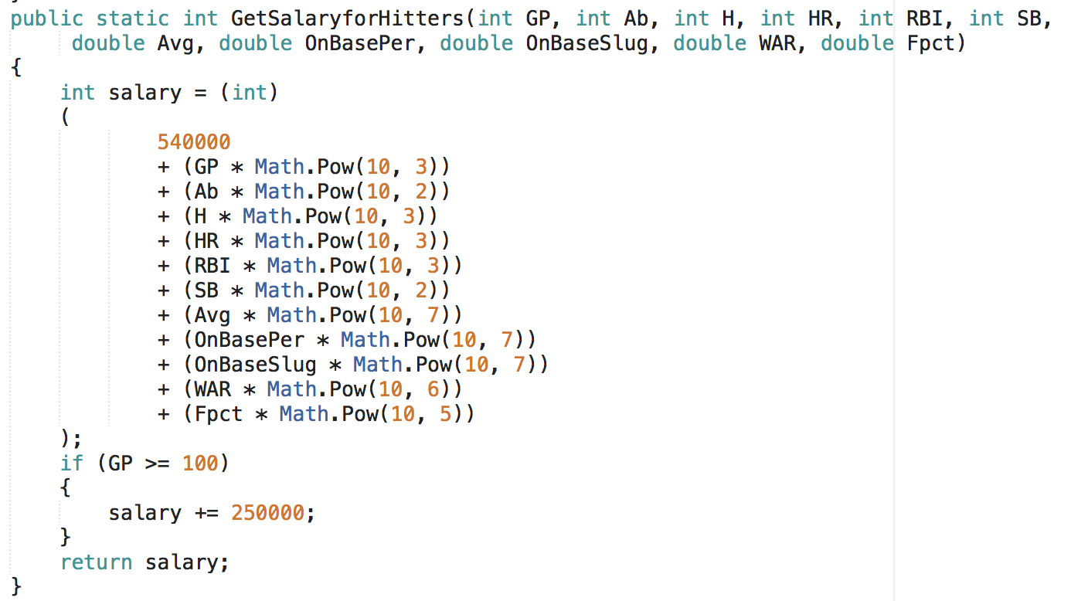
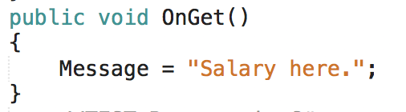
Method
Here we are able to grab what the users inputs and multiply by our math calculations. There is a rule that if Games Played reached over 100 then $250,000 would be added.
For our OnGet(): it was just to display a message before displaying the salary once calculated.

Slide 24
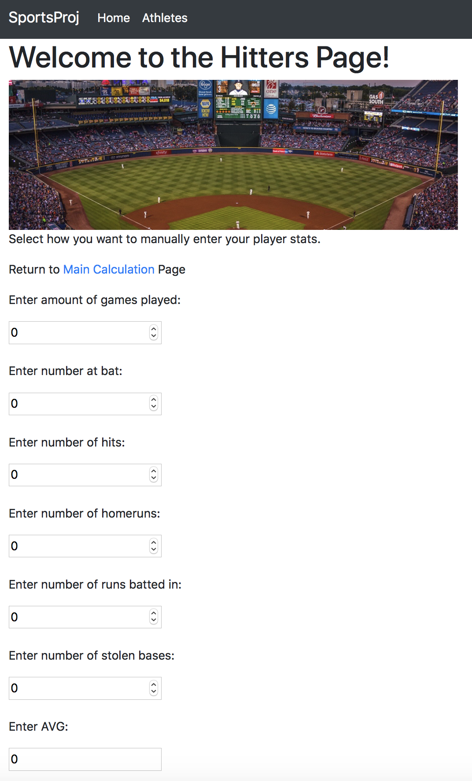
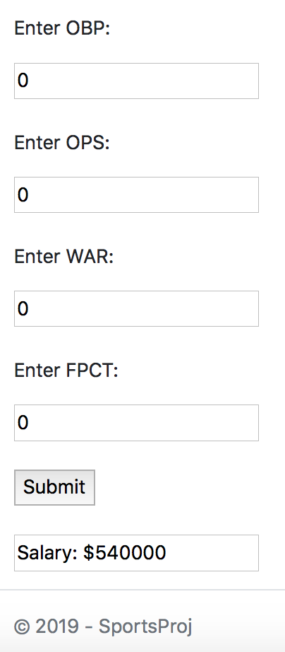
Hitters
Whatever the user inputs, those numbers would be under a form with an input asp-for tag assigned to their tag helper names. When submitted it will use the OnPost action. Then it will display in the salary message.

Slide 25
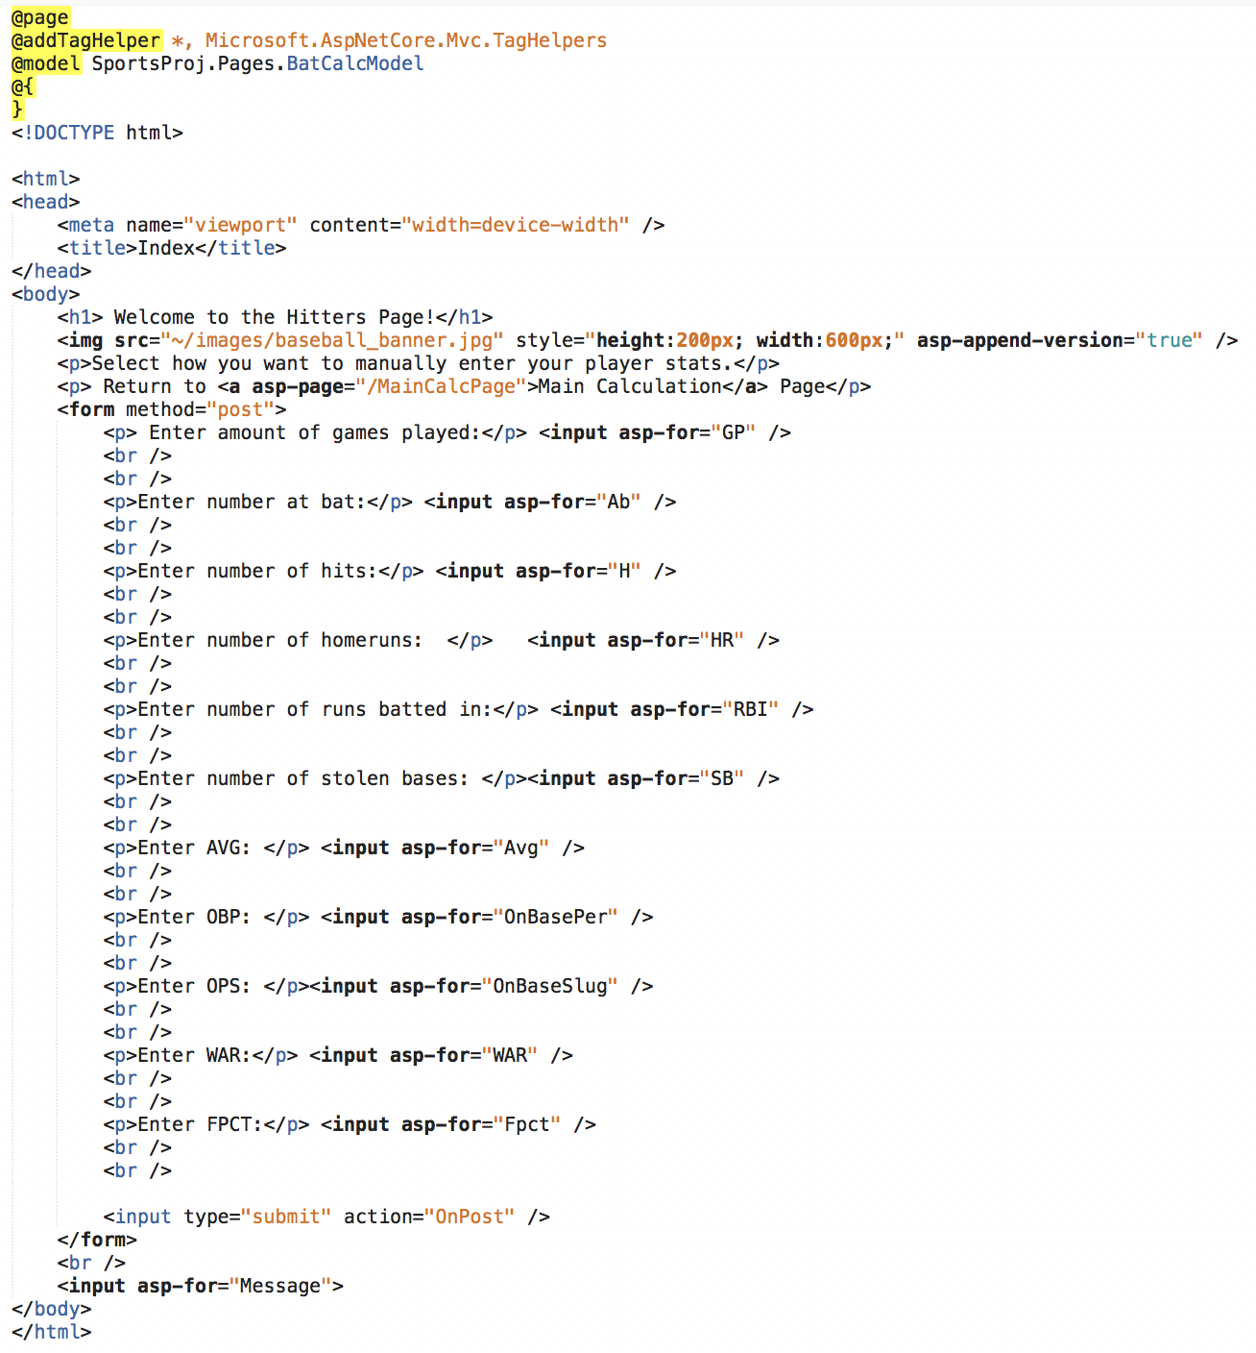
Hitters HTML
Noted again:
Whatever the user inputs, those numbers would be under a form with an input asp-for tag assigned to their tag helper names. When submitted it will use the OnPost action. Then it will display in the salary message.

Slide 26
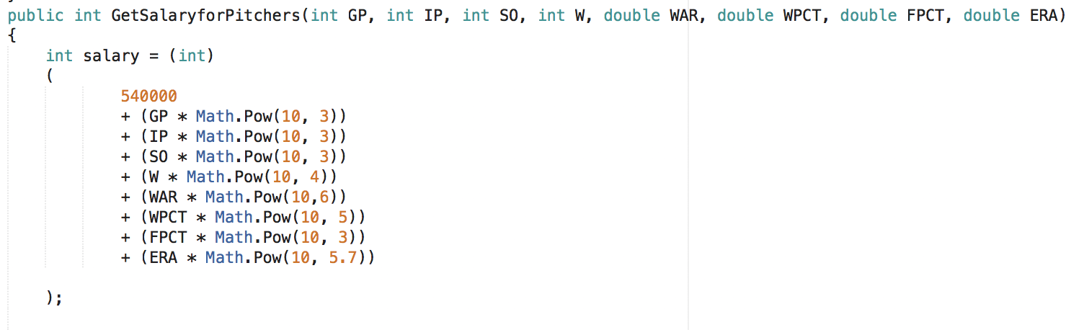
Pitchers
Had to adjust calculations from test cases to get close to Mark’s Test cases. Notice for ERA which stands for earned run average.

Slide 27
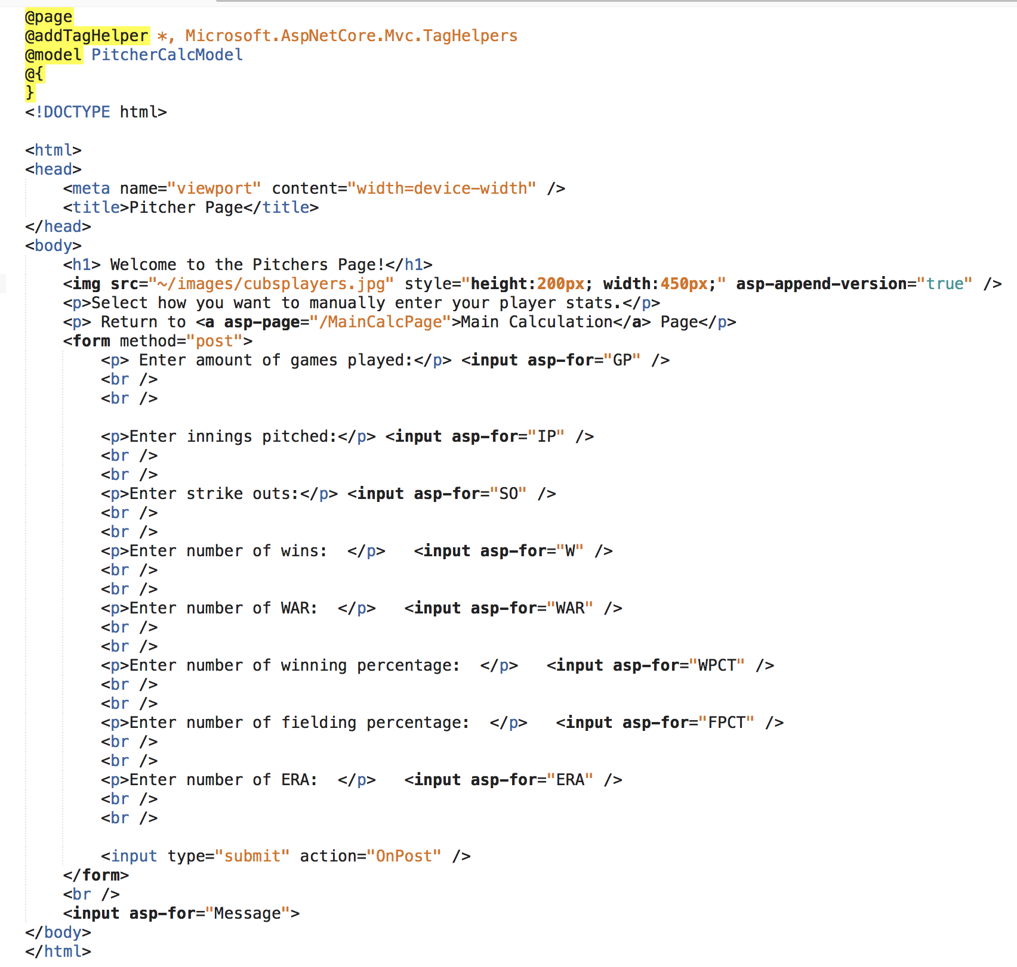
Pitchers HTML
Whatever the user inputs, those numbers would be under a form with an input asp-for tag assigned to their tag helper names. When submitted it will use the OnPost action. Then it will display in the salary message.

Slide 28
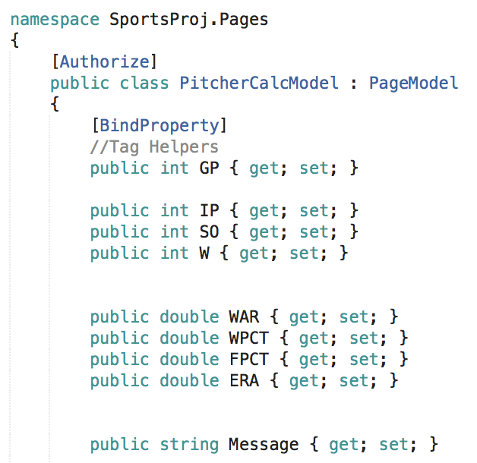
Pitchers .cshtml.cs File
Here we have the [Authorize] bracket which forces the user to sign up and login to have access to the calculator.
Within the model you have tag helpers so we can use them in the .cshtml file

Slide 29
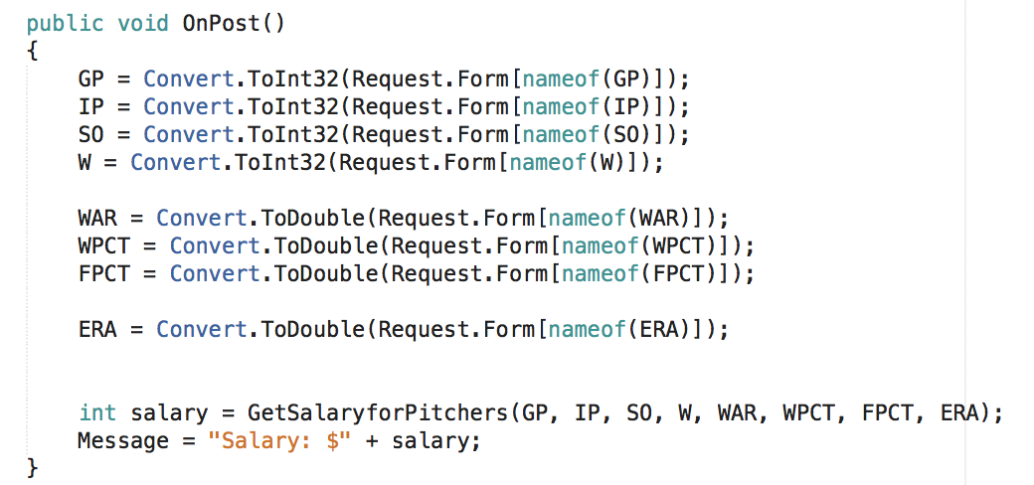
Pitchers .cshtml.cs File
This OnPost() method is the action on the html side. Under the form tag you will see this name under the action =“OnPost”
The requirements whether it is an integer, double, etc will come from the tag helpers mainly and Convert.ToInt32(Request.Form[nameof()]);

Slide 30
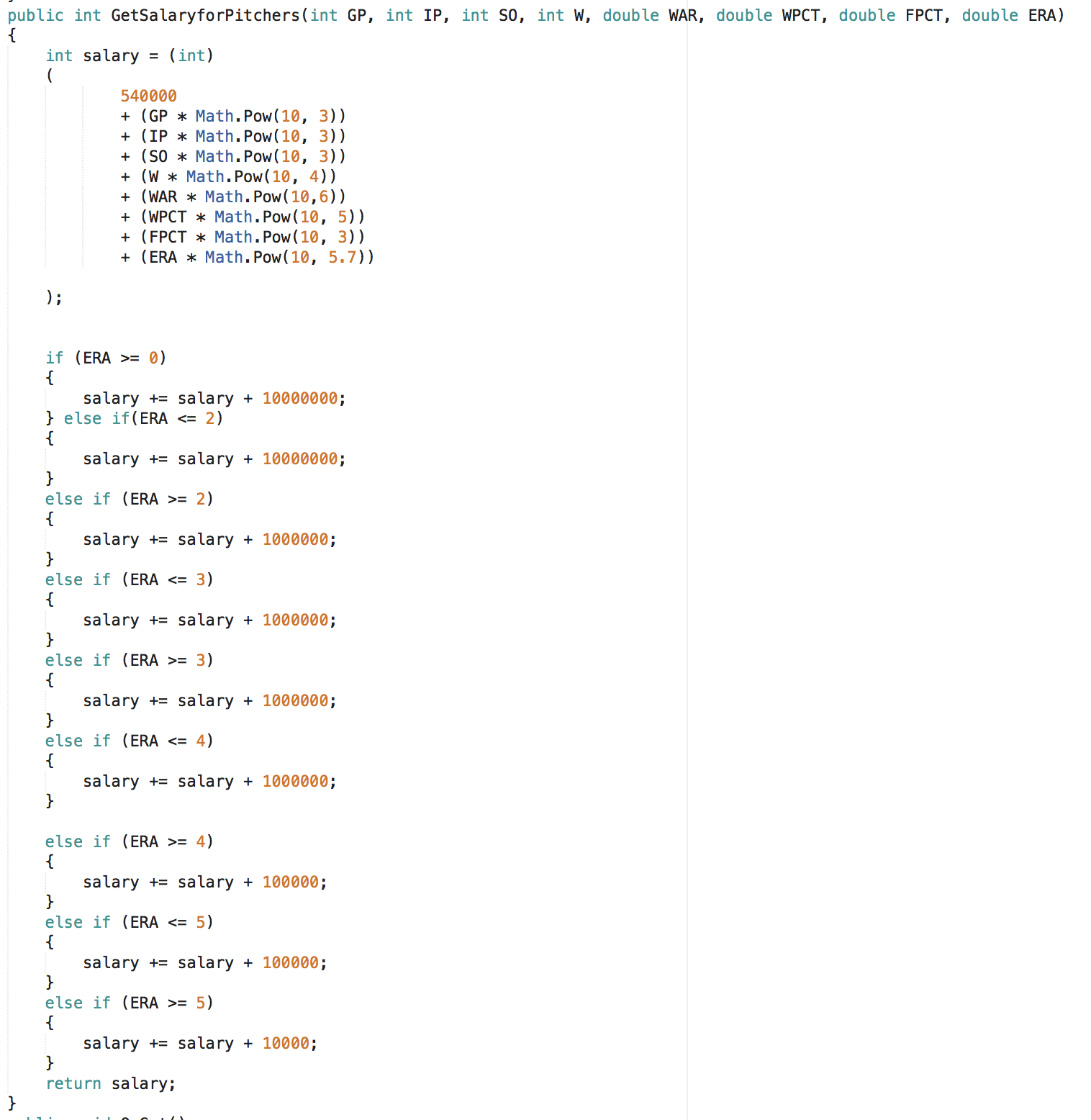
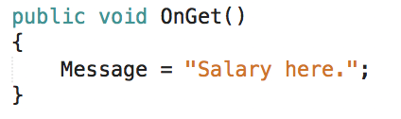
Pitcher Method
Here we are able to grab what the users inputs and multiply by our math calculations.
With the ERA: (Earned Run Average) There is a variety with what the user inputs; it would add to the salary differently.
Then a method to for our OnGet(): it was just to display a message before displaying the salary once calculated.

Slide 31
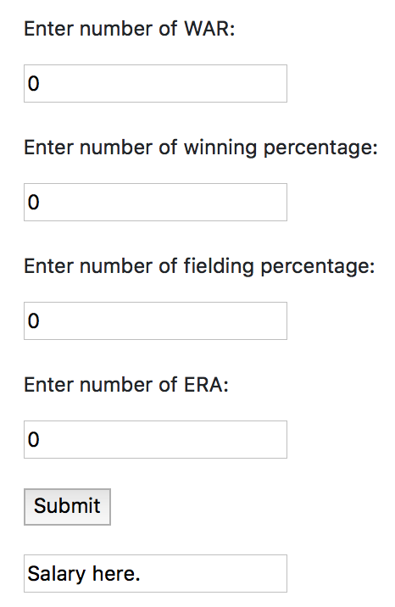
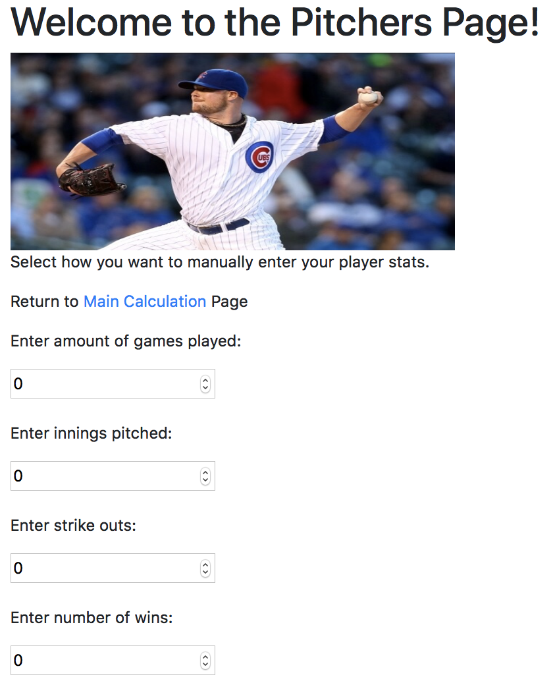
Pitchers Front-End Page

Slide 32

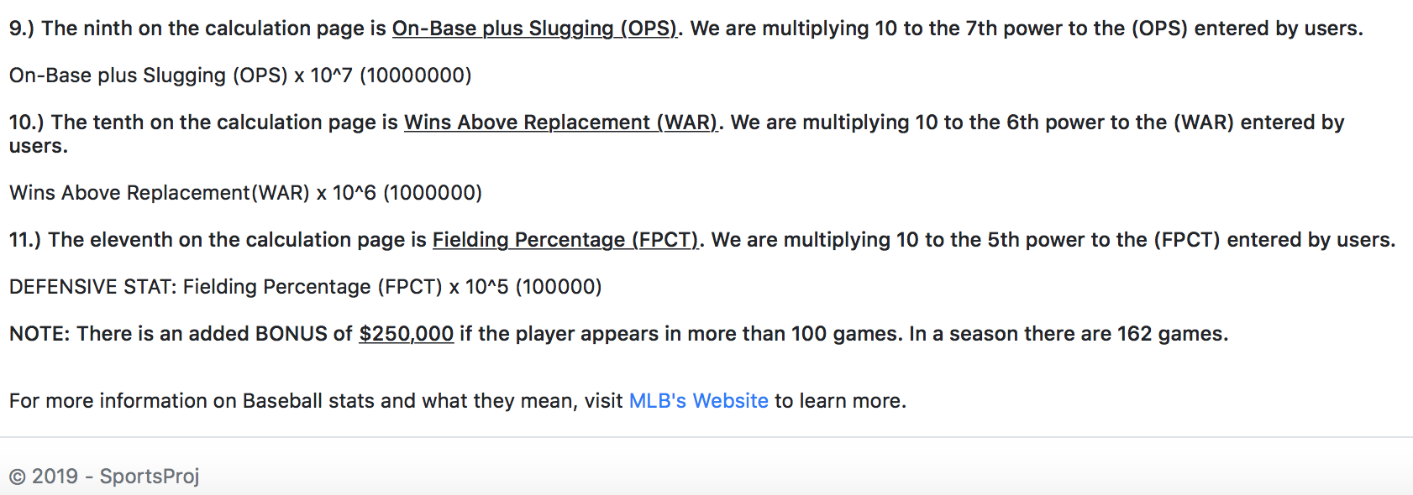
Batting Behind the Scences
I clarified each stats on what they stand for and what math calculation we used. Along with the pitchers stats.

Slide 33


Slide 34
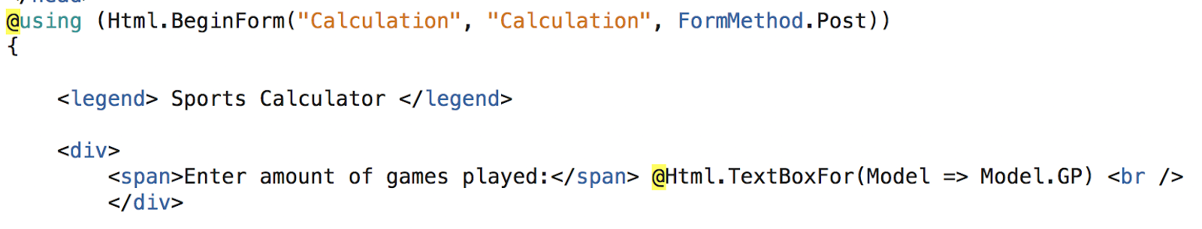
HTML.begin Form
https://www.aspsnippets.com/Articles/ASPNet-MVC-HtmlBeginForm-Tutorial-with-example.aspx https://www.google.com/amp/s/blog.michaelckennedy.net/2012/01/20/building-asp-net-mvc-forms-with-razor/amp/ https://gist.github.com/esouto/3179020 https://www.completecsharptutorial.com/asp-net-mvc5/html-beginform-example-tutorial-aspnet-mvc5.php
Note: Was not able to get this communicating with methods in .cshtml.cs file. Noticed that this feature was originally MVC related. It was able to display what the user entered but didn’t do the job when incorporating methods.

Slide 35
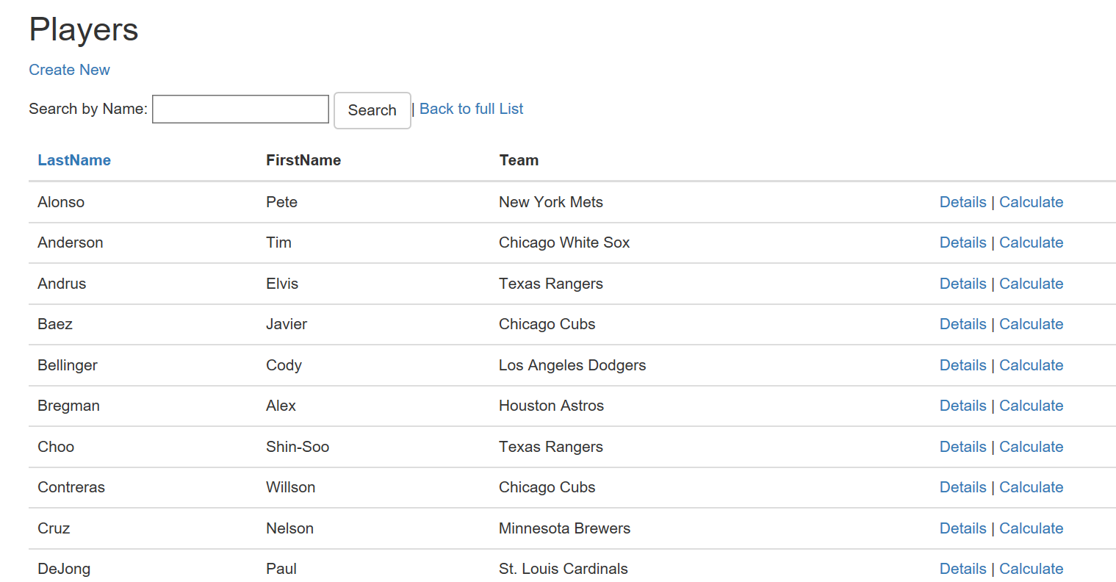
Search
Take a look at Kristina’s Documentation:
I was not able to incorporate her search feature because I needed Docker to connect with SQL Server
Check Out: https://database.guide/how-to-install-sql-server-on-a-mac/
https://docs.docker.com/docker-for-mac/install/

Slide 36
Uploading to Server
Check out Matt’s Documentation
I was able to include my code up into the server. Here are screen shoots of the process.

Slide 37
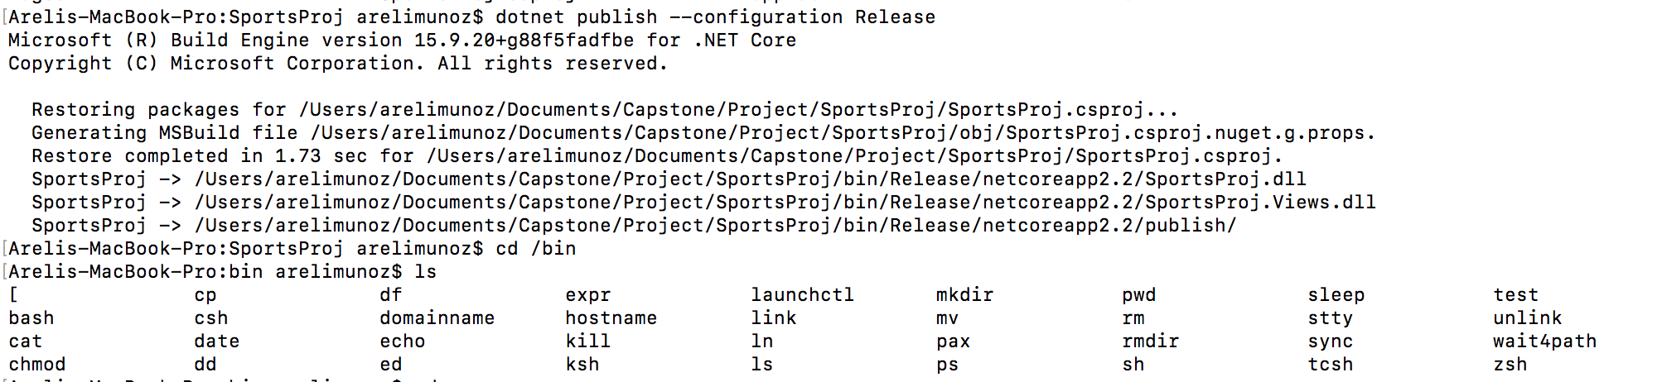

Slide 38
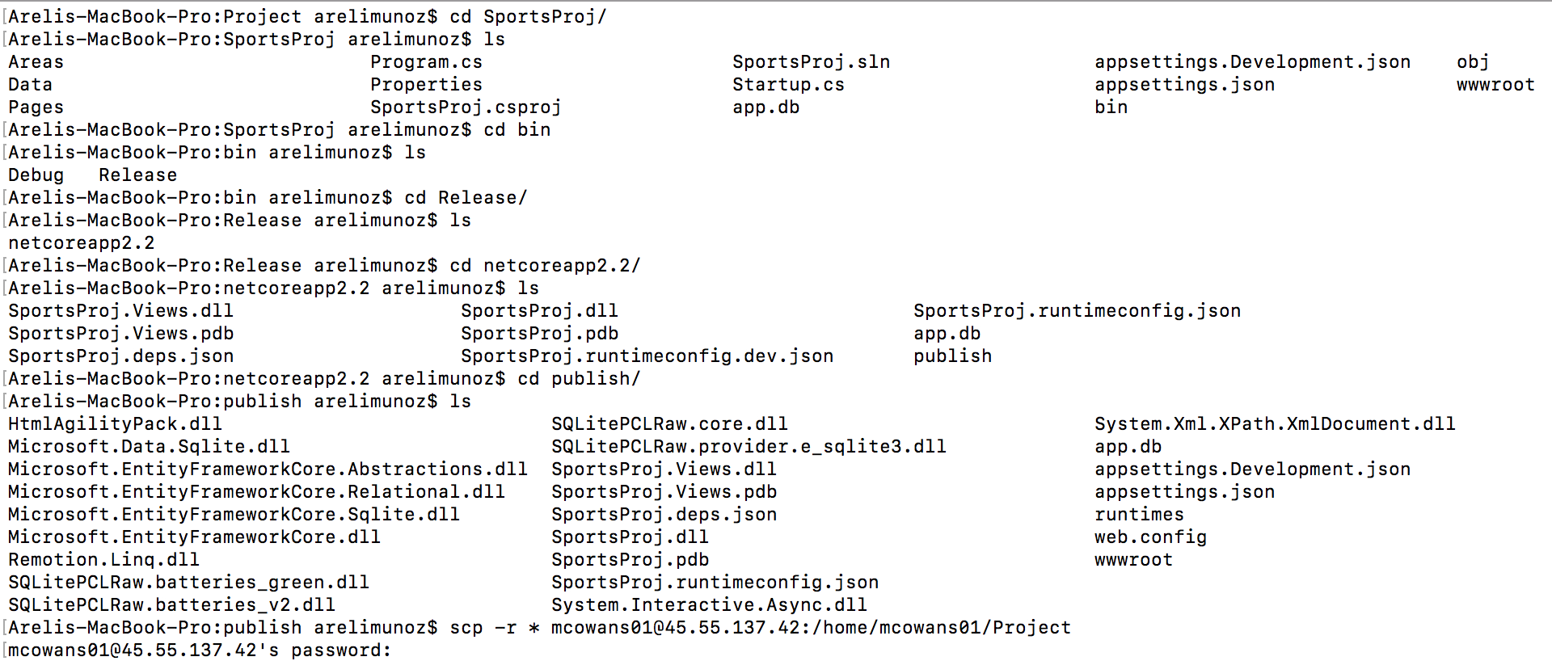

Slide 39
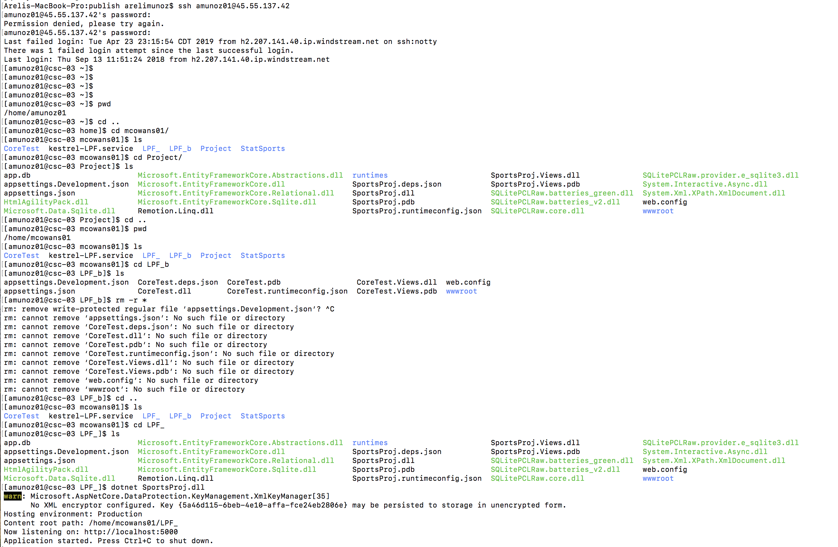

Slide 40
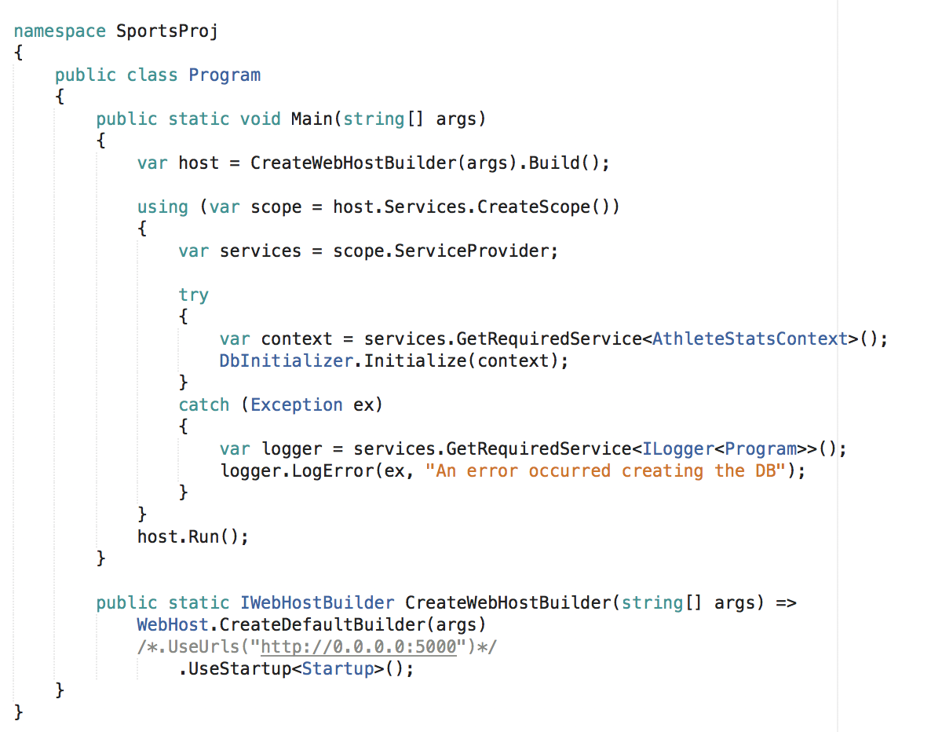
Include the part commented out before publishing everything!! This is located in Program.cs file.

Slide 41
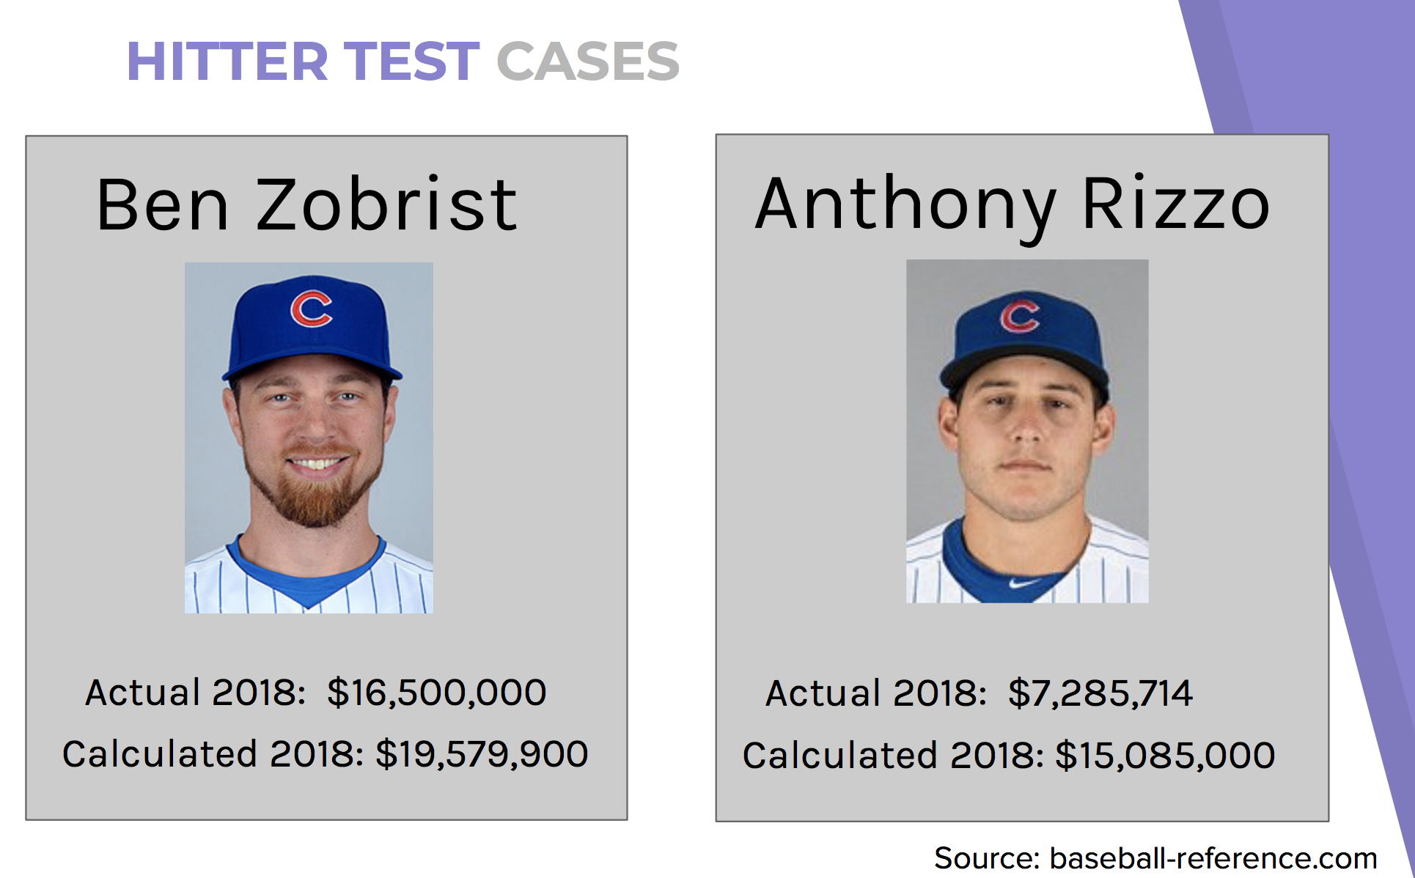
Test Cases
Take a look at Mark’s Documentation for specific test cases in calculating these numbers.

Slide 42
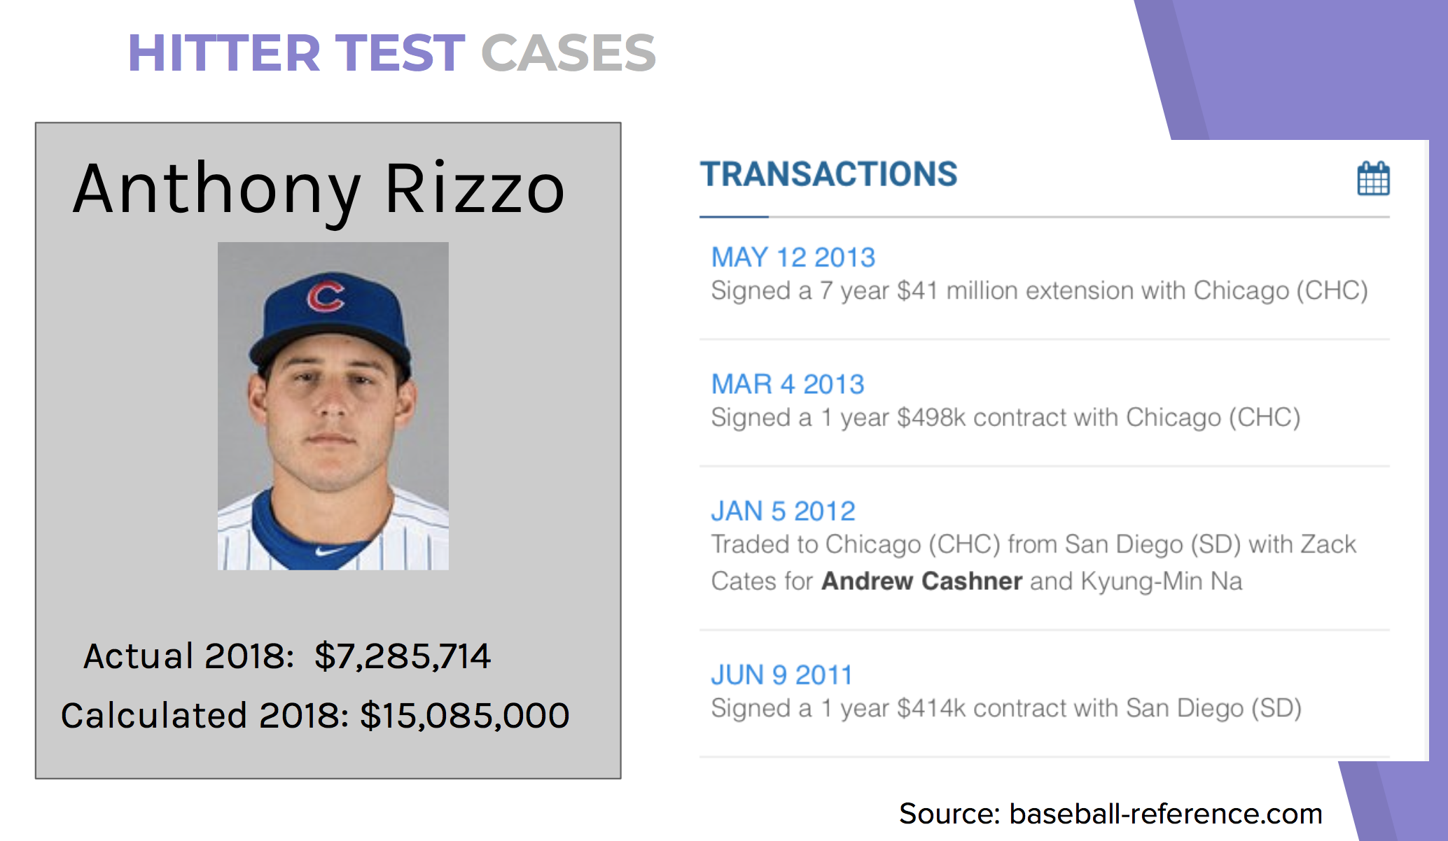

Slide 43
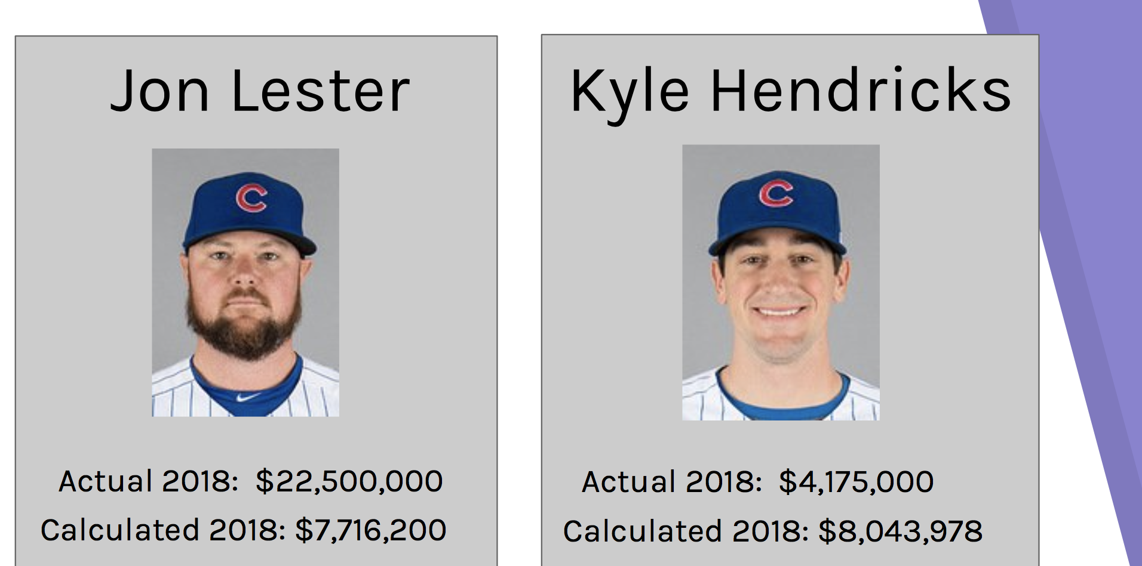

Slide 44
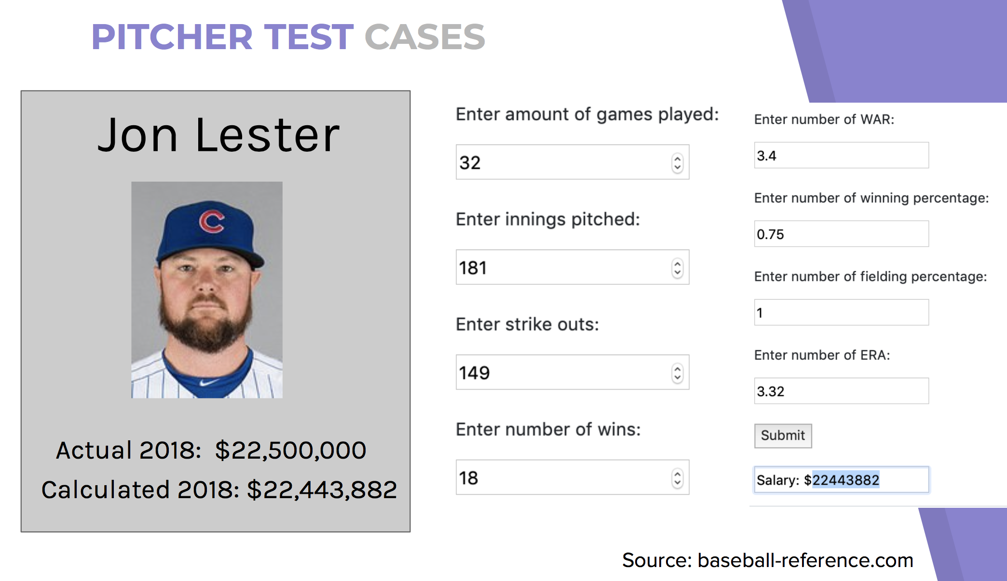

Slide 45
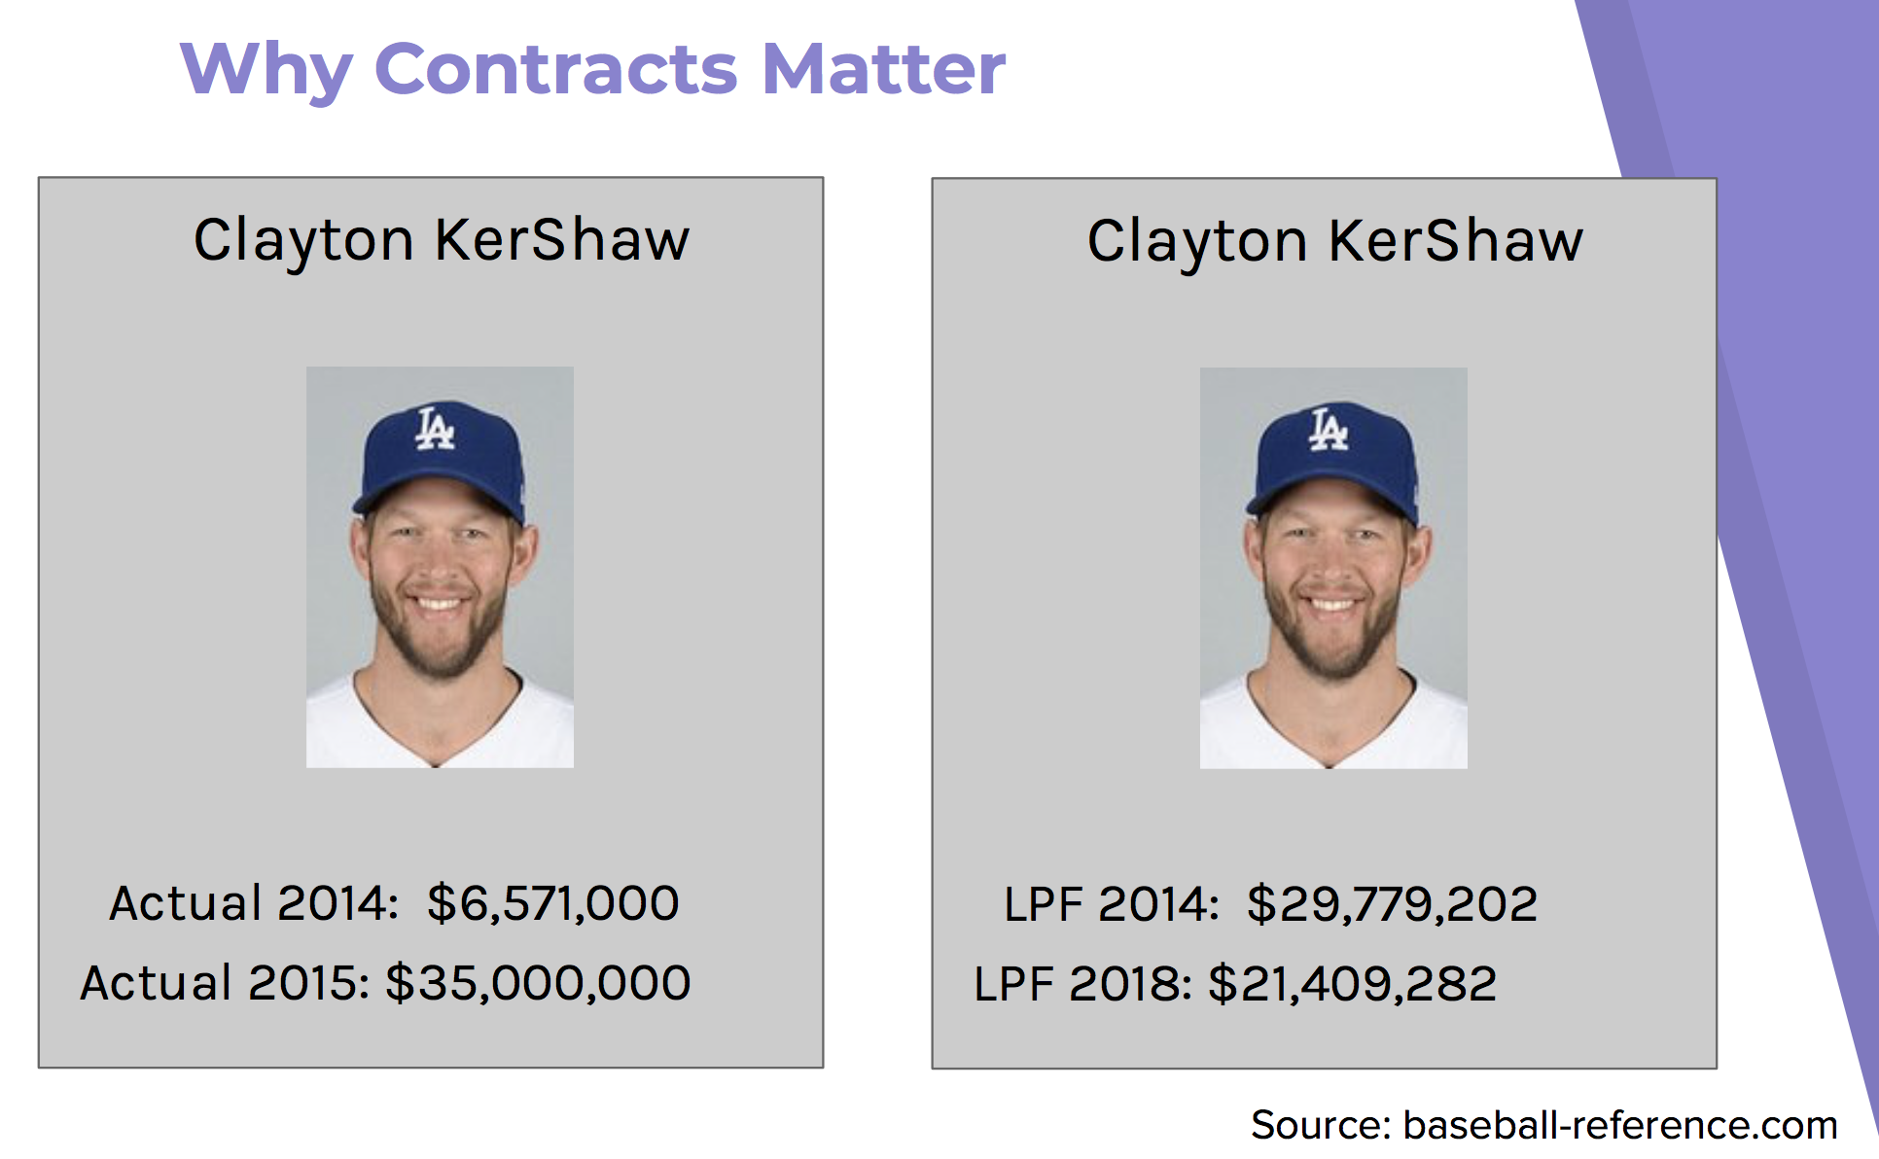

Slide 46
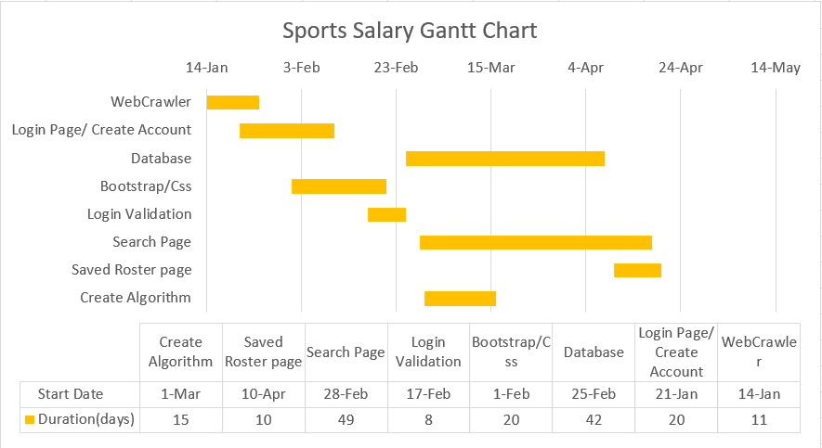

Slide 47
Links I Researched:
GETTING started:
https://docs.microsoft.com/en-us/dotnet/core/tutorials/using-on-mac-vs
https://docs.microsoft.com/en-us/visualstudio/get-started/csharp/tutorial-aspnet-core?view=vs-2019
Models:
https://docs.microsoft.com/en-us/aspnet/core/tutorials/razor-pages/model?view=aspnetcore-2.2&tabs=visual-studio
Example to set up the format in Razor Pages:
https://github.com/ardalis/OrganizingAspNetCore/tree/master/WithRazorPages
Understanding what is MVC:
https://jakeydocs.readthedocs.io/en/latest/mvc/controllers/actions.html
https://evolpin.wordpress.com/2011/05/09/mvc-and-posting-data-using-html-beginform-and-url-routing/
Razor Syntax:
https://docs.microsoft.com/en-us/aspnet/core/mvc/views/razor?view=aspnetcore-2.2
Random Searches:
https://blog.michaelckennedy.net/2012/01/20/building-asp-net-mvc-forms-with-razor/
https://www.completecsharptutorial.com/asp-net-mvc5/html-actionlink-complete-example-aspnet-mvc5.php
https://docs.microsoft.com/en-us/aspnet/core/tutorials/razor-pages/model?view=aspnetcore-2.2&tabs=visual-studio-mac
https://www.grapecity.com/en/blogs/razor-pages-vs-aspdotnet-mvc
https://www.learnrazorpages.com/razor-pages
https://www.foreach.be/blog/create-a-custom-html-helper-in-asp-net-mvc-using-razor
https://www.learnrazorpages.com/razor-pages/model-binding
https://docs.microsoft.com/en-us/dotnet/csharp/
https://docs.microsoft.com/en-us/aspnet/core/tutorials/razor-pages/sql?view=aspnetcore-2.2&tabs=visual-studio
https://msdn.microsoft.com/en-us/magazine/mt842512.aspx
https://stackoverflow.com/questions/25879593/create-a-simple-class-and-call-its-method-from-a-cshtml-file-without-using-app-c
https://docs.microsoft.com/en-us/dotnet/api/microsoft.extensions.primitives.stringvalues?view=aspnetcore-2.2

Slide 48
Scaffolding:
https://github.com/aspnet/AspNetCore.Docs/issues/7014
https://www.learnrazorpages.com/miscellaneous/scaffolding
HTML Research:
https://www.w3docs.com/learn-html/html-iframe-tag.html
https://forums.asp.net/t/1380684.aspx?How+to+embed+a+webpage+inside+a+webpage
https://docs.microsoft.com/en-us/aspnet/web-pages/overview/ui-layouts-and-themes/3-creating-a-consistent-look
Images HTML:
https://docs.microsoft.com/en-us/aspnet/core/mvc/views/tag-helpers/built-in/image-tag-helper?view=aspnetcore-2.2
https://www.w3schools.com/tags/att_img_align.asp
https://stackoverflow.com/questions/32263702/how-to-center-an-image-in-asp-net
https://stackoverflow.com/questions/15986980/how-to-display-an-image-from-a-path-in-asp-net-mvc-4-and-razor-view
C# code tutorials:
http://www.csharp-examples.net/switch/
https://www.tutorialsteacher.com/codeeditor?cid=cs-6Ms0MY
https://www.tutorialsteacher.com/csharp/csharp-tuple
Errors:
https://stackoverflow.com/questions/20066556/does-not-contain-a-definition-for-and-no-extension-method-accepting-a-first-argu
https://github.com/aspnet/Scaffolding/issues/305
ASP.NET Core:
https://www.tutorialspoint.com/asp.net_core/asp.net_core_razor_view_import.htm
Validation:
https://www.youtube.com/watch?v=b63m66eu7us&feature=youtu.be

Slide 49
Connected Services trouble Mac :
https://stackoverflow.com/questions/36378440/could-not-load-file-or-assembly-microsoft-visualstudio-connectedservices-how-t
https://github.com/Microsoft/ConnectedServices/blob/master/SDK/articles/CreatingAConnectedServiceExtension.md
https://docs.microsoft.com/en-us/visualstudio/mac/connected-services?view=vsmac-2019
https://developercommunity.visualstudio.com/content/problem/223951/not-able-to-add-connected-service.html
https://developercommunity.visualstudio.com/content/problem/146309/connected-services-plugin-does-not-appear-in-proje.html
https://docs.microsoft.com/en-us/visualstudio/mac/connected-services?view=vsmac-2019
Extentions for visual studio:
https://marketplace.visualstudio.com/vs
https://devblogs.microsoft.com/visualstudio/use-your-favorite-extensions-with-visual-studio-2019/
Razor Link:
https://forums.asp.net/t/2140094.aspx?Razor+page+link+creation
Looking at stats:
http://www.espn.com/mlb/stats/batting/_/sort/hits/order/true
SQL Express troubleshoot:
https://stackoverflow.com/questions/5283727/what-is-the-sql-connection-string-i-need-to-use-to-access-localhost-sqlexpress-w
Error Random:
https://stackoverflow.com/questions/40708119/cannot-implicitly-convert-type-void-to-object-error-in-c-sharp
HTML.FORM Research:
https://stackoverflow.com/questions/46884784/cannot-apply-indexing-with-to-an-expression-of-type-httprequest

